Slide 1

地球趣墾
LEE CHIH-CHIN
SHYU CHASE JHIH-HUANG
JYH CHERNG JAN
CHEN WEI-CHIH
YU-HSIN HSUEH

Slide 2

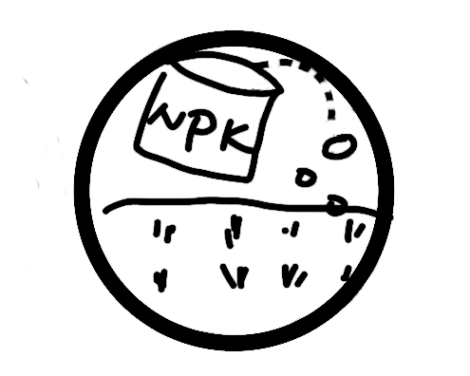



Carboin A NEW CURRENCY
Goal: You will need to find out how to accumulate a large fortune through balancing your capital profit ($P) and carbon reduction ($C) in harvesting timber or crop and reducing carbon footprint.
目標: 找尋適合的氣候、土地條件，種植適合的物產，過程中累積碳足跡與金錢，尋找單位金錢最小碳足跡的勝利方程式。
Fertilize
Choose a type of plant
$C $P
Buy a land
Irrigate
Increase asset
Harvest

